Slide 1
Guidance Requirements
The regulations intend to amend both the repairing standard under the Housing (Scotland) Act 2006 and the right to repair scheme under the Housing (Scotland) Act 2001 to introduce new duties to investigate reports of damp and mould and commence any required repairs within a set timescale, unless it is not reasonably practicable for the landlord to do so.
They also plan to implement changes to the Minimum Standards for Gypsy/Traveller Accommodation, as part of a wider review, so that buildings on pitches provided by Social Landlords benefit from investigations and repairs in the same way.

Slide 2
Considerations
Timescales – those adopted in England will be similar to us
Definitions - Awaab’s Law should be implemented and build upon Scotland’s existing housing framework.
Enforcement: current enforcement procedures are likely sufficient, however any impacts on the Ombudsman and Tribunal need to be considered.
Guidance & Education: The importance of clear communications and guidance for landlords and tenants, with tenants knowing how, and to whom, issues should be reported.
Provision of alternative accommodation: The potential impact upon the PRS and local authorities.

Slide 3
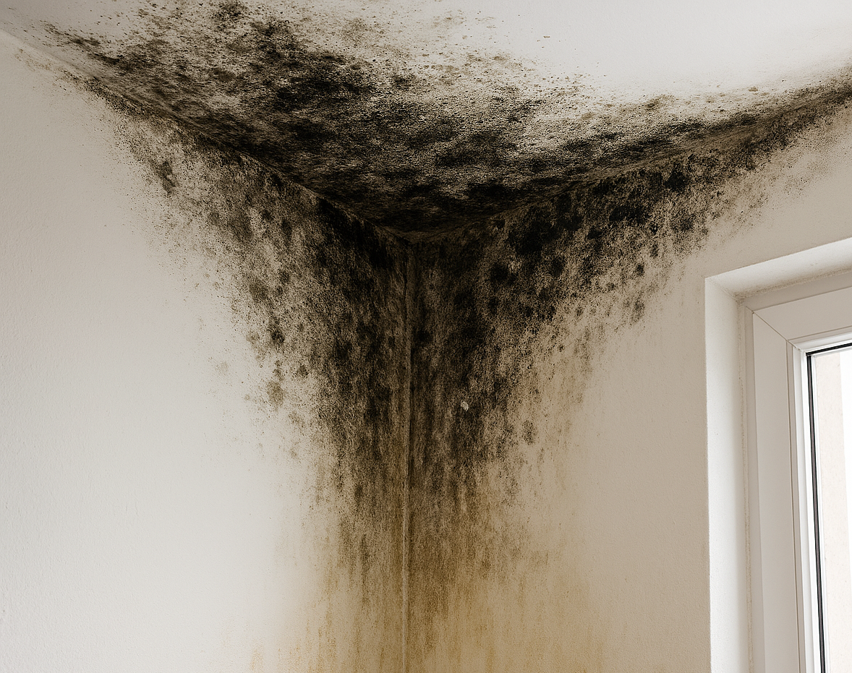
Known Risk Areas for Consideration
The main areas of risk for England are areas for us to consider ahead of implementation, these were:
Lack of surveying resources
Lack of administration resources
Lack of clarity/inefficient processes/decision making, e.g. when to abandon jobs and inspections following no access

Slide 4
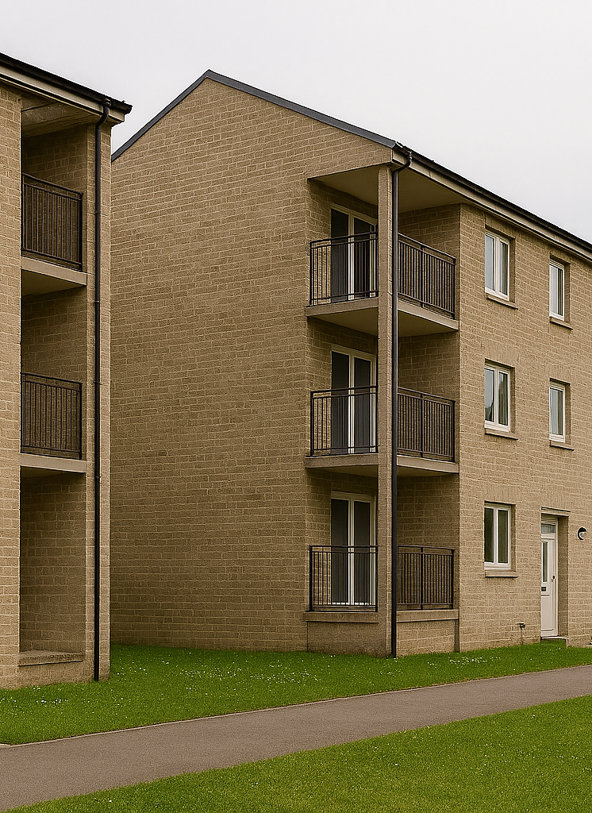
Discussion points
Although we respond to emergency repairs timeously across the sector, how will this additional repair type impact on our response timescales? Trade personnel capacity? investigation timescales?
Capacity to react and respond.
Case management – IT systems ability to record data & capacity for admin support. Effective data recording is key!
No Access – how do we effectively manage this
Ambulance Chasers!

Slide 5

Questions ??

