Slide 1


Argyll Community Housing Association and Argyll and Bute Council in Partnership
13/08/2026
Doug Moyes and Douglas Whyte

Slide 2
The Housing Market in Argyll and Bute
The Housing Emergency in Argyll & Bute is driven by a complex range of issues with the scale of housing shortage and housing system pressure evident in the following statistics:
3,290
people on housing waiting lists in 2023 (up 8% on 2022). Argyll & Bute has 5% less social housing than average
28%
Increase in the number of households presenting as homeless in Argyll & Bute, in total 511 households
£206k
average housing price in 2022. This is 7 times average income levels in Argyll & Bute
11%
of all homes in Argyll & Bute are either second homes (6%) or empty (4%)
43%
of property sales are made to households living out with Argyll and Bute
131
private housing completions outside Helensburgh in the last 5 years on sites of 5+ units
17% of the expected rate (780)
22%
increase in 2022 construction costs 2022 (BICS) with island costs significantly higher
75%
of employers who responded to the workforce housing survey said a shortage of housing was a barrier to recruiting or retaining staff

Slide 3
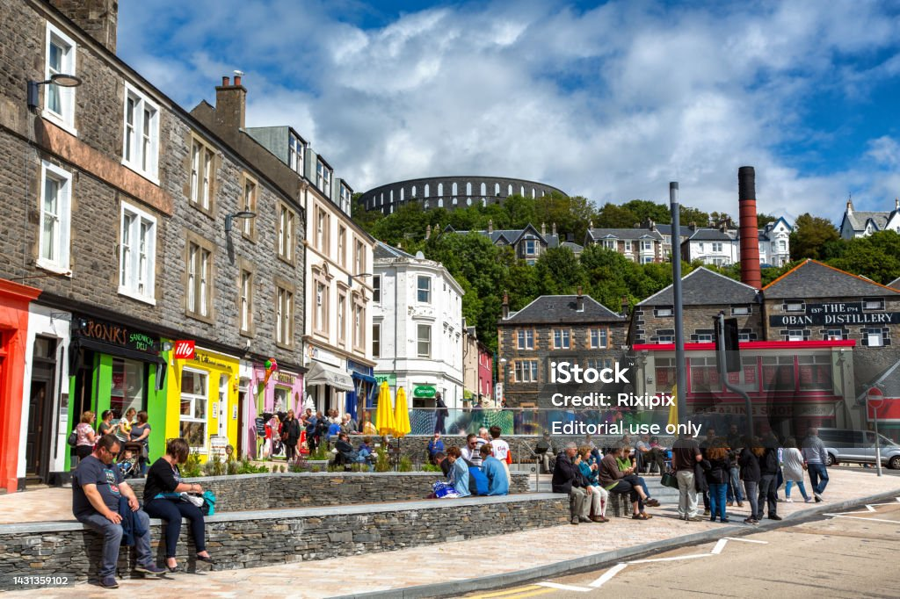
Affordable Homes: Key Issues
There are c. 8,800 units of social housing, 18% of all stock which 5% lower than Scotland
Social rented stock has increased by just 3% (262 units) over last 5 years
Total vacancies in social housing have reduced by 20% since before the pandemic
There is 6 applicants for every available social let in Argyll & Bute (10:1 in Coll & Tiree)
In 2022/23, homeless applications were up by 28% on 2021/22, at 511 applications
Whilst the SHIP programmes the delivery of 1,000 affordable housing units between 2023-28, there has been 3 consecutive years of underspend in the programme
Home Argyll identifies significant demand for intermediate housing with limited delivery in the SHIP

Slide 4
Community View
October 2023 – 2 surveys launched
688 responses to the community survey
72 responses to the workforce survey
92% of respondents felt that their communities were negatively impacted by the housing shortage

Slide 5
Housing Emergency Metrics
HOUSING EMERGENCY - METRICS
Year (as of 1st April)
Measures | Baseline 2022/23 | 2023/24 | 2024/25
Housing Completions – All Tenures | 340 (180 Affordable) | 144 (70 Affordable) | 78 (44 Affordable)
Residential Dwellings Granted Planning | 289 units | 536 units | 531 units
Resource Planning Allocation (RPA) | £18.31m | £18.264m | £14m
Resource Planning Allocation (RPA) spend | £6.173m | £8.157m | £10.693m
Strategic Housing Fund (SHF) spend | £1.574m | £1.057m | £1.184m
Number of Homeless Applications | 512 | 492 | 459
Number of Households on HOMEArgyll register (social housing) | 3,289 | 3,209 | 3,117
House Price Affordability | 5.45 x Median income | 5x Median income | 5x Median income
Total Number of Short Term Let Licence (STL) Applications | n/a | 3,031 | 2,949
Number of Second Homes | 2,874 | 2,811 | 2,605
Number of Empty Homes (incl exempt & empty) | 1,135 + 809 exempt = 1,944 | 1,451 + 913 exempt = 2,364 | 2,205 +910 exempt = 3,115

Slide 6


Slide 7
Thank you
Any Questions?
Doug.moyes@acha.co.uk
Douglas.whyte@Argyll-bute.gov.uk

