Slide 1

ALACHO Deep Dive
Stock Turnover and Generating Housing opportunities – Fife Housing Emergency Perspective
Gavin Smith
Service manager, housing access
Vice President Elect - CIH

Slide 2
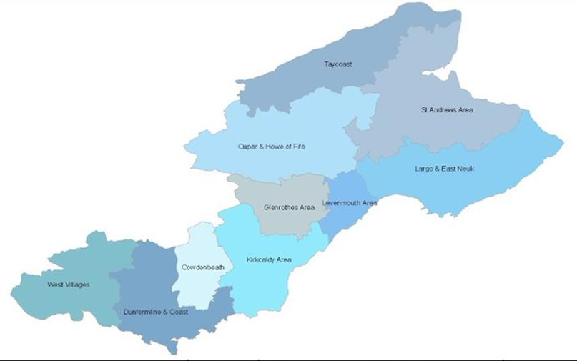
The Fife Context
Stock Profile – around 31,500 properties across Fife (Just over 900 Temp +)
Urban and Rural context – managed through 7 Area Operations Teams and specialist functional support Teams
Housing Access – Fife Housing Register covering 99.3% of social rented stock managed by FHR Executive (FC and Fife based RSLs)
Turnover – between 2000-2500 properties per year, flipping and replacement has suppressed opportunities
New build 50/50 split with Fife Housing Association Alliance
Housing Demand
  FHR -13,500 (all in) – 600 new applications per month
  Homelessness – 2,600 relatively static, around 1,800 Open / Live cases

Slide 3

Transfer Led
Started with New Build (General Needs) in 2011
Specific Needs – best use of stock approach
Wider Transfer Led Approach adopted in the pandemic / post pandemic period (Approach – not policy so able to be relaxed
Best Use of Stock and Local Lettings Plans / Community Lettings Initiatives enshrined in the Policy Framework agreed by Cabinet Committee in December 2025
Transfer Incentives – need supply to work
Decentralised Housing Options delivery through Accredited Officers and Policy Compliance

Slide 4
Focus on Voids
Voids Masterplan
Flip 300-400 properties per year (0 days void)
Divert similar numbers to GFHA with minimal void periods
Around 250 new builds per year – 0 days void
Increase time available to make best use of more specialist properties
Quotas set at local level
Developing tools through Transfer Incentives, Inter-organisational transfers and other access initiatives
Voids Governance through Building Services Partnership
Enhancing focus on the pre-void period through Housing Operating Model Review and specialised teams

Slide 5
The Voids ‘Industry’
Identifying stock to divert and making other options available (PSL, Homes for Good and potentially others)
Diverting early to manage the CoT process efficiently
Co-ordinating Flips and tracking need at a local level – avoiding concentrations in higher turnover areas
Managing temporary accommodation efficiently with a focus on occupation and welfare / wellbeing
Co-ordinating structural and more significant repairs
Updating Exit and Relet standards in 2026

Slide 6
A radical allocations and housing options based approach (work in progress)
Commitment based Common Assessment of Need
Housing Options Front End to the Access System supported by high quality housing advice and Housing Options / Personal Housing Plans
Self Service with enhanced case management where needed – central FHR support role needs to change
Local Lettings Plans take the ‘prize’ out of homelessness priority
Potential to divert homeless presentations (estimated around 900 p.a.)
Changing ‘face’ and ‘use’ of temporary accommodation – focus on crisis response, interim and supported. Rapid rehousing becomes default
Expectations will need to be managed!

Slide 7


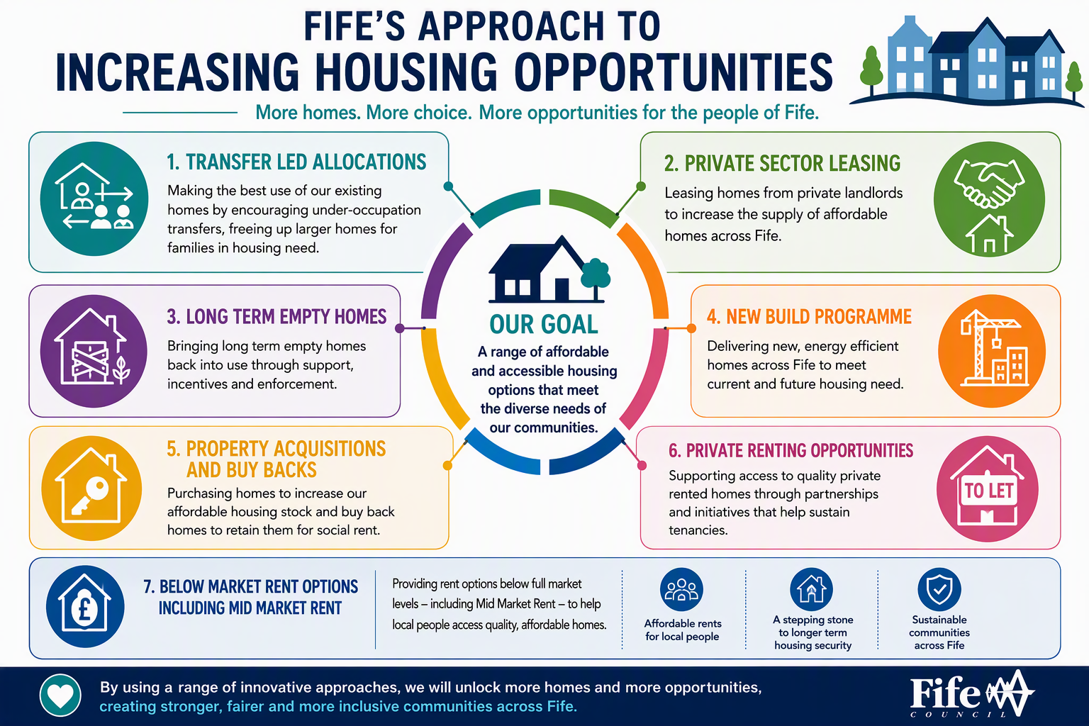




Slide 8
Statutory Compliance
Rapid Access / Crisis Response in Kirkcaldy
1,200 furnished tenancies in the community, flip and replace process – jump started by the Kirkcaldy Sheriff Court Judgement but now mainstreamed to 300 per year
Voids process generating opportunities to make the best use
Children in temporary accommodation – accelerated from 360 – circa 500 over the last 6-8 months
Developing models of supported accommodation and accommodation with support – directly provided and commissioned
PRS Intervention - Fife Landlord Partnership (PSL), Homes for Good Co-production & LTEH progress – still around 2,600 LTEHs in the private sector
Housing First Programme – developing a Housing First + programme
Specialised models to meet complex needs

Slide 9
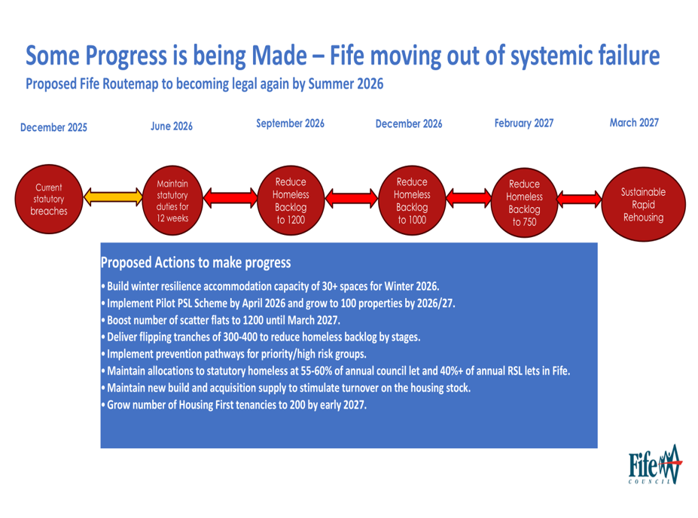
The Route Map

Slide 10
Questions and Discussion
Would longer term homelessness funding help – are General Funds making a contribution to the Housing Emergency / Housing Pressures environment?
Can we sustain the ‘industry’ of rapid rehousing?
Why is turnover in decline across the country – are there local factors or is it a systemic issue
How are local authorities developing a housing options environment giving PRS issues etc.

