Slide 1

Housing supply and stock turn over
August 13 2026
introduction

Slide 2
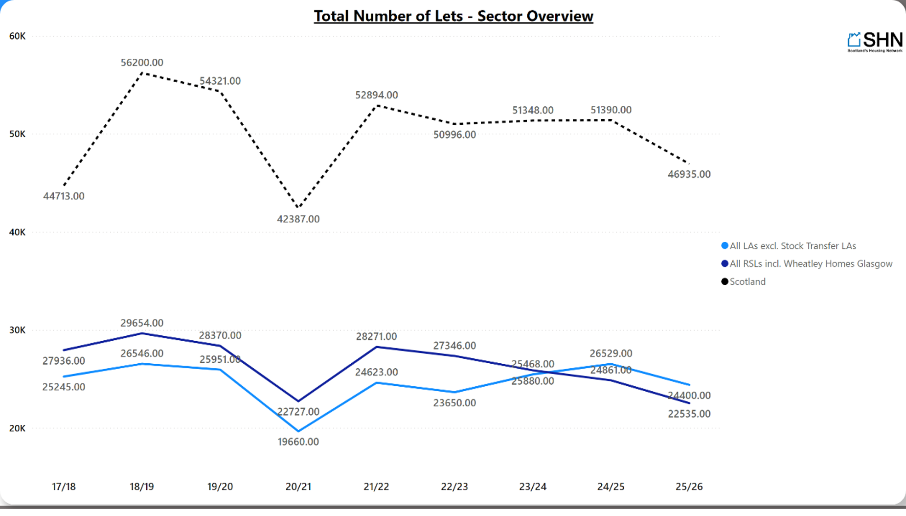

Slide 4
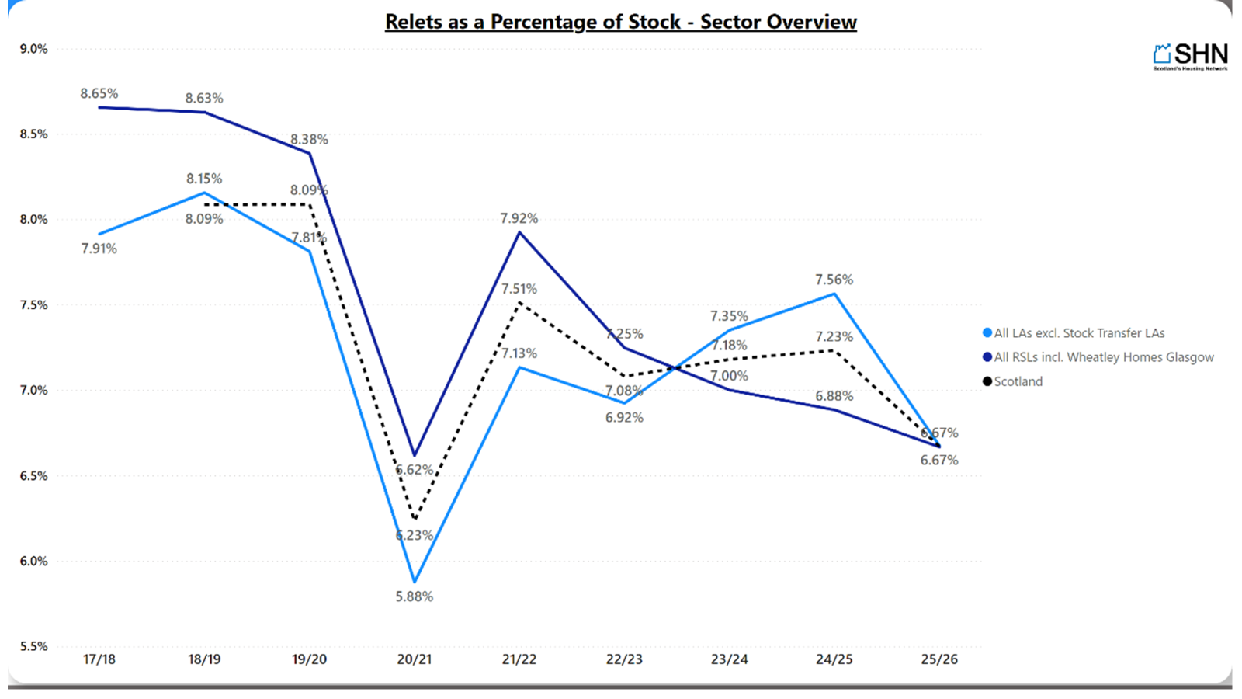

Slide 5
